Slide 1
The EURIPOS Project: European Research Network of Ionospheric and Plasmaspheric Observation Systems
Anna Belehaki
National Observatory of Athens, Greece
Fifth European Space Weather Week, Brussels, 17-21 November 2008

Slide 2
The idea
16 European academic institutes gathered together to develop a system for real-time monitoring, modelling and forecasting the complex ionosphere-plasmasphere system providing new opportunities to researchers through:
wide and efficient access to the ground- and space-based facilities of the observational network,
access to standardized and validated observational data, and
development of e-services.

Slide 3
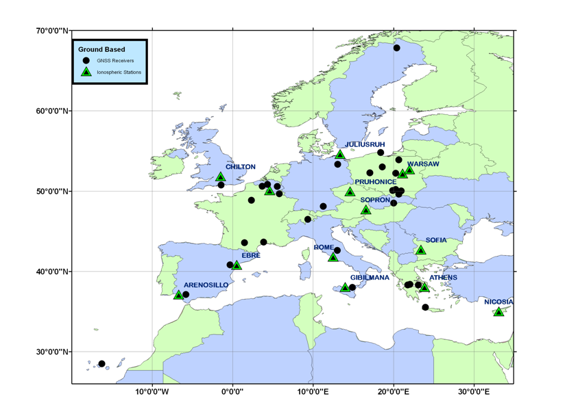
EURIPOS Group
EISCAT
SGO
IAP
RAL
SRC
INTA
INTA
RMI
DLR
IAP-P
GGKI
ENS
BKG
INGV
BAS
URL
INTA
UOA
NOA
FU

Slide 4
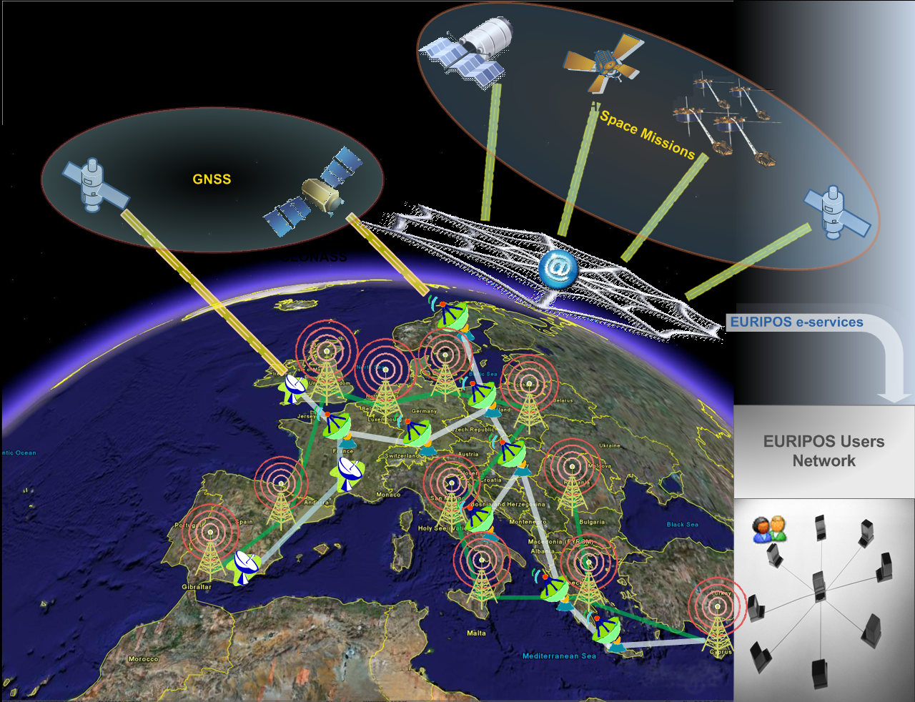
EURIPOS observational facilities
Ground-based ionospheric stations
Ground and space-based GNSS receivers
Data from space missions: solar wind, ionosphere, plasmasphere, magnetosphere

Slide 5
EURIPOS background
http://dias.space.noa.gr
DIAS system: a European network of ionospheric sounders that provides HF propagation characteristics and ionospheric storm forecasts
http://w3swaci.dlr.de
SWACI system: nowcasts ionospheric conditions based on ground and space based GNSS data

Slide 6
EURIPOS foreground
ACE at L1
ISIS data base
GNSS
IMAGE mission (RPI)
GNSS
DIAS system: a European network of ionospheric sounders that provides HF propagation characteristics and ionospheric storm forecasts
GNSS
CHAMP mission
High latitude ionospheric observations
GNSS
SWACI system: nowcasts ionospheric conditions based on ground and space based GNSS data
GNSS
Mediterranean ionospheric sounders
GNSS
GNSS

Slide 7
EURIPOS
Implementation Plan
Coordination of Stakeholders Network
Models and algorithms for the development of new research products
Dissemination and Exploitation
EURIPOS testbed
Experiments and special campaigns
EURIPOS USERS

Slide 8
EURIPOS research investments
Major tasks:
Integration of ionospheric sounders to the DIAS network from the Mediterranean region, the middle latitudes and the high latitudes
Drastic improvement of ionospheric mapping technique
Implementation of new solar wind driven models to issue forecasts and alerts for ionospheric disturbances
Development of a digisonde built-in tool for the electron density reconstruction up to the transition height
Plasmaspheric specification through data ingestion techniques using DIAS, SWACI, CHAMP, IMAGE and ISIS data.

Slide 9
Why ionosondes?
A note from Henry Rishbeth
INAG Bulletin 2008
Re: Ionosondes.
I have no new great thoughts but I still use ionosonde data in my current work. So I again stress that a basic network remains vital for monitoring the solar-terrestrial environment. Times have changed, especially with the advent of continuous global total electron content (TEC) data, but TEC does not give the detail that ionosondes do - especially the very important critical frequencies / peak electron densities.

Slide 10
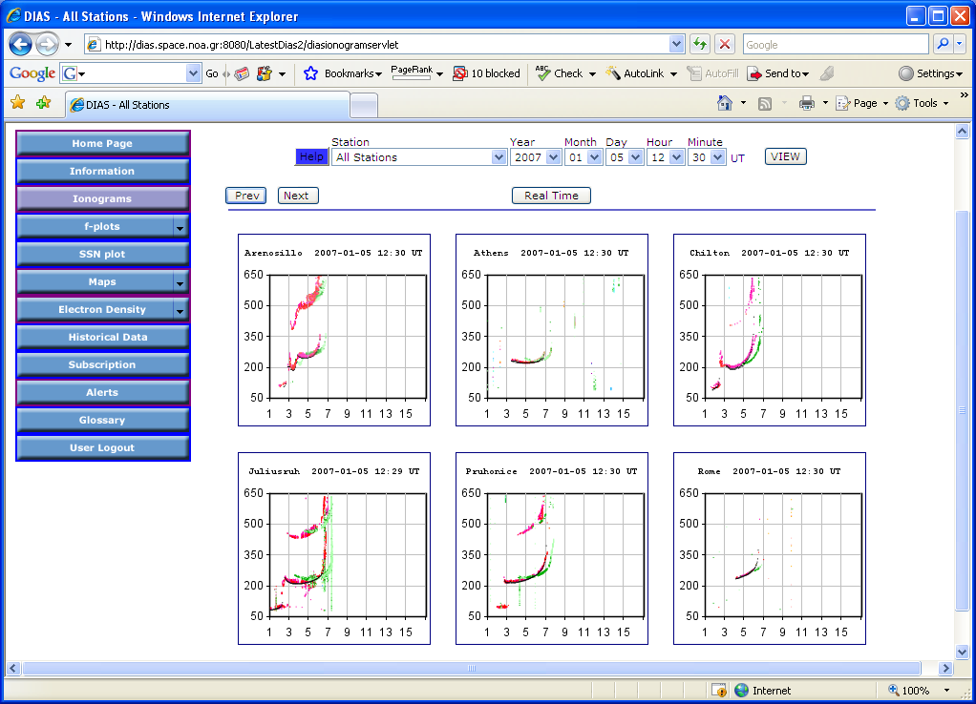
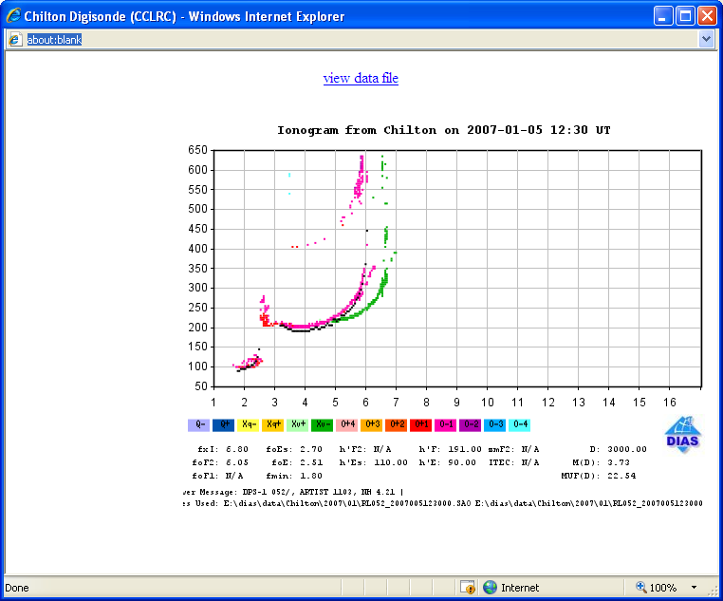
DIAS ionograms: the top product
Parameters in ASCII

Slide 11
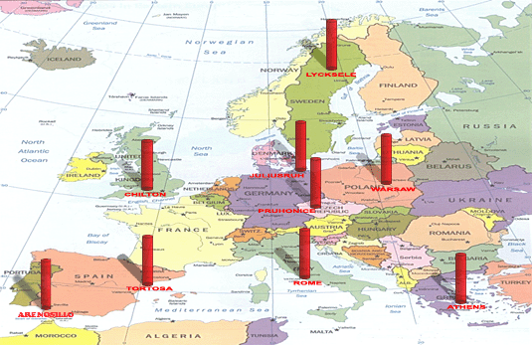
Existing DIAS network

Slide 12
A proposal for the expanded EURIPOS network

Slide 13
The problem of ionospheric prediction
“Short-term (1–24 h in advance) ionospheric F2-layer forecast is still an unsolved and very challenging problem …
The problem is in intensity of each particular process contributing to a particular ionospheric storm formation. The Earth’s upper atmosphere is an open system with many uncontrolled inputs forcing it both from above and below. If solar EUV radiation, magnetospheric electric fields, particle precipitation (impact from above) can be controlled to some extent, the intensity of internal gravity waves, dynamo and tropospheric electric fields, planetary waves (impact from below) are uncontrolled in principle.”
from Mikhailov et al., 2007

Slide 14
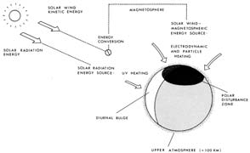
SOLAR WIND KINETIC
ENERGY
MAGNETOSPHERE
SOLAR WIND – MAGNETOSPHERE ENERGY SOURCE
ENERGY
CONVERSION
PARTICLE AND ELECTRODYNAMIC HEATING
SOLAR RADIATION
ENERGY SOURCE SW HEATING
POLAR DISTURBANCE ZONE
Heat sources of the upper atmosphere:
Solar radiation
Solar kinetic energy
(G.W. Prölss, 2005)
DIURNAL BULGE
UPPER ATMOSPHERE (400 KM)
Solar wind kinetic energy is partly captured by the Earth’s magnetosphere via a magnetoplasmadynamic generator process. This way solar wind kinetic energy is transformed into electromagnetic energy and subsequently transferred to the polar region by electric currents and accelerated particles.

Slide 15
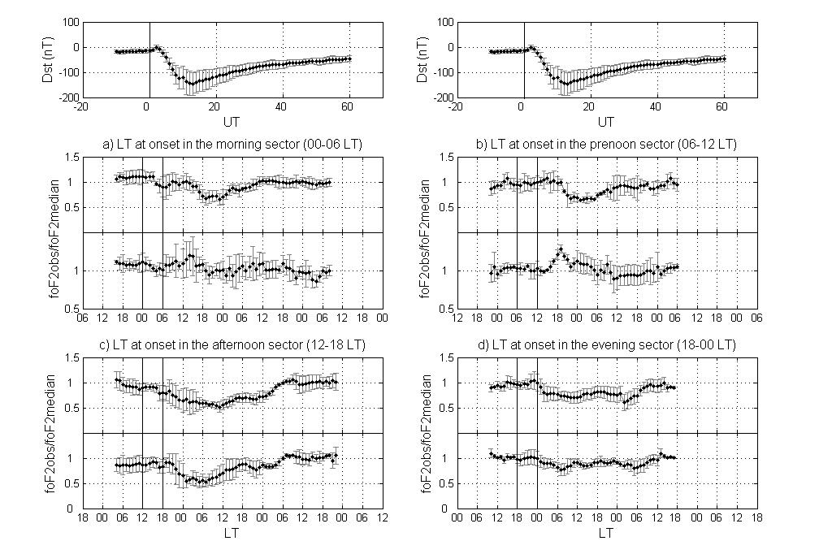
Tsagouri and Belehaki, 2008

Slide 16
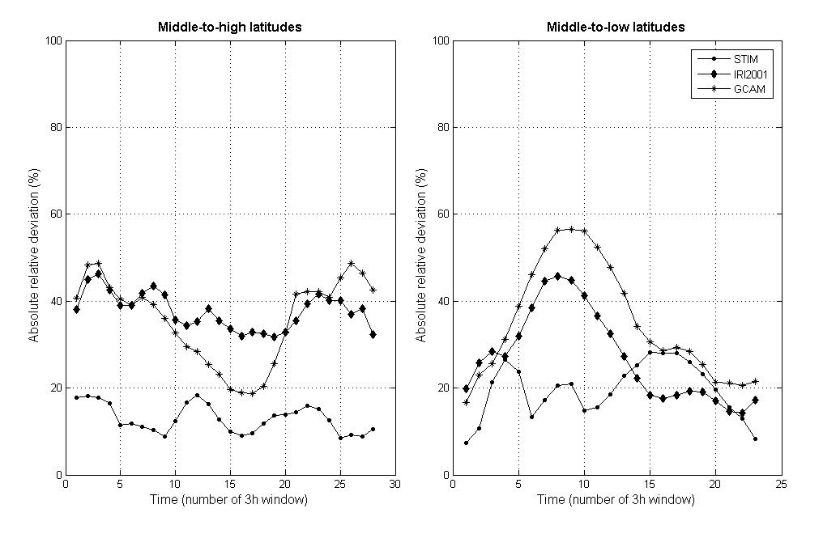
Tsagouri and Belehaki, 2008

Slide 17
Plasmaspheric specification
Development of models based on bottomside electron density profiles
Combination of model profilers with topside measurements
Radio occultation measurements
In situ measurements (IMAGE, Cluster)
Physical models

Slide 18
Belehaki et al., 2006

Slide 19
Topside Sounder Model (TSM)
Kutiev et al, 2006

Slide 21
A sample Ne profile, obtained on 05 February 1969. (Kutiev et al., ESWW5, Poster Session 4).

Slide 22
TSMP-assisted Digisonde profiles (red)
Profiles calculated by using TSM parameters (blue)
CHAMP-based reconstruction (Heise et al., 2002) profiles (green)

Slide 23
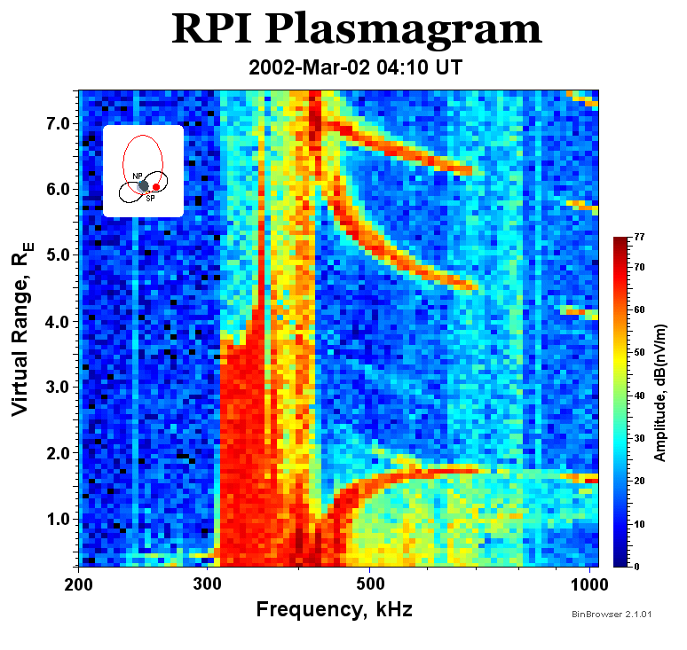
field-guided echoes

Slide 24
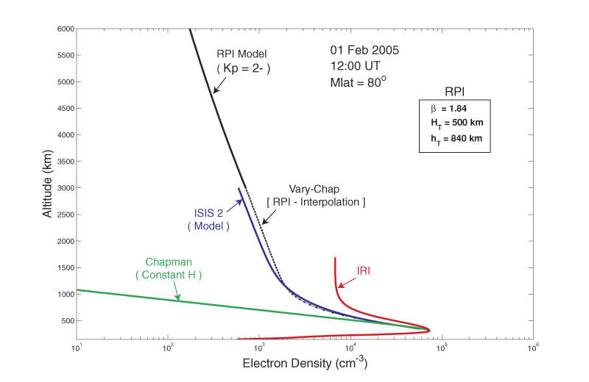
Validation with RPI plasmagrams
Courtesy, Bodo Reinisch

Slide 25
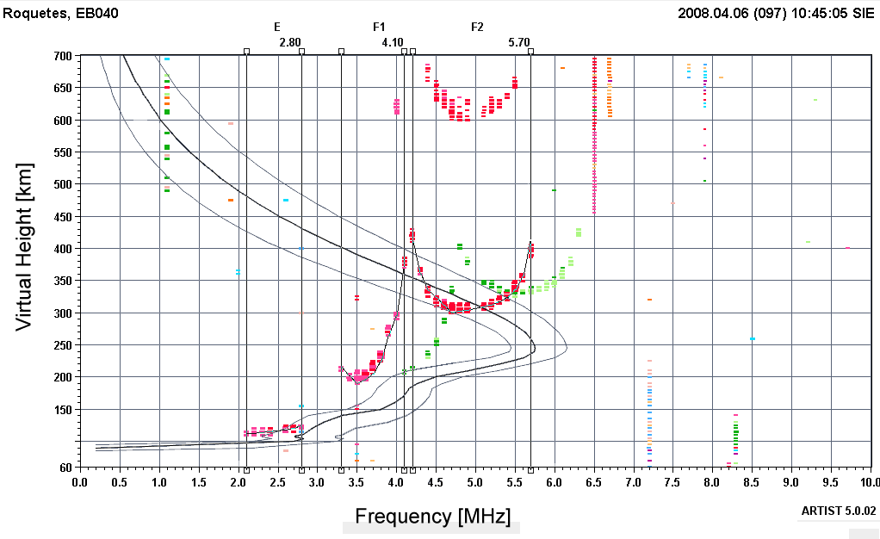
ARTIST 5: Profile Error Boundaries

Slide 26
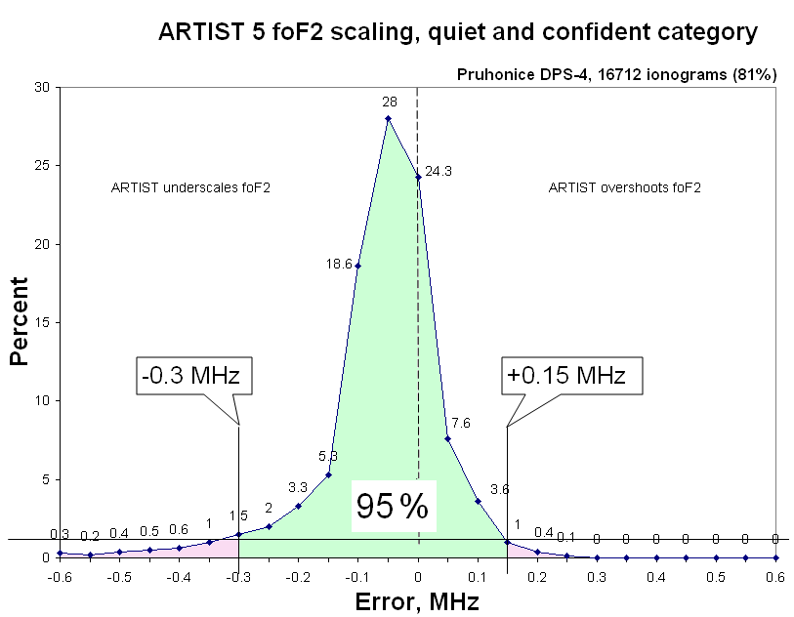
foF2 Error Bars
~ 250,000 manually scaled ionograms used to obtain error histograms
For details: Galkin et al., 2008

Slide 27
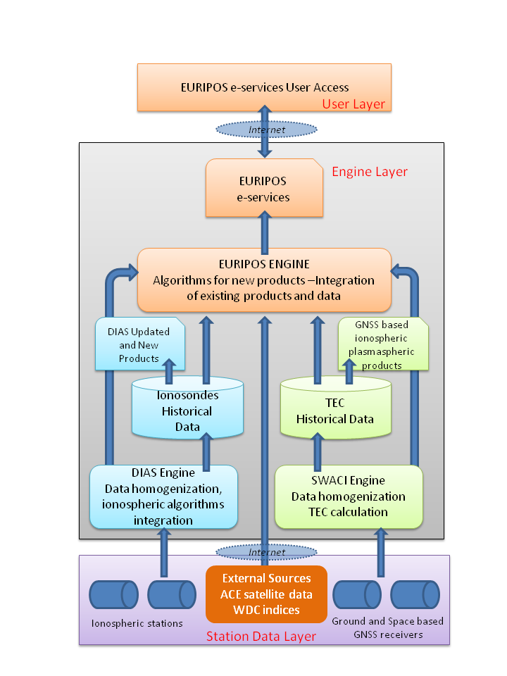
External Resources
ACE, IMAGE, EISCAT, WDC and RWC indices

Slide 28
EURIPOS forum
The aim of the forum is:
to promote EURIPOS concept and
to exchange ideas with the research community for new methods, models and monitoring facilities that can be integrated to EURIPOS
Your active participation is welcome!

Slide 29
EURIPOS session in EGU 2009
EGU Vienna 19-24 April 2009
ST12 EURIPOS: Observing and modeling the Earth’s ionosphere and plasmasphere
Conveners: Anna Belehaki, Bruno Zolesi and Pierre Briole
Deadline for abstracts submission:
17 January 2009

